Slide 1
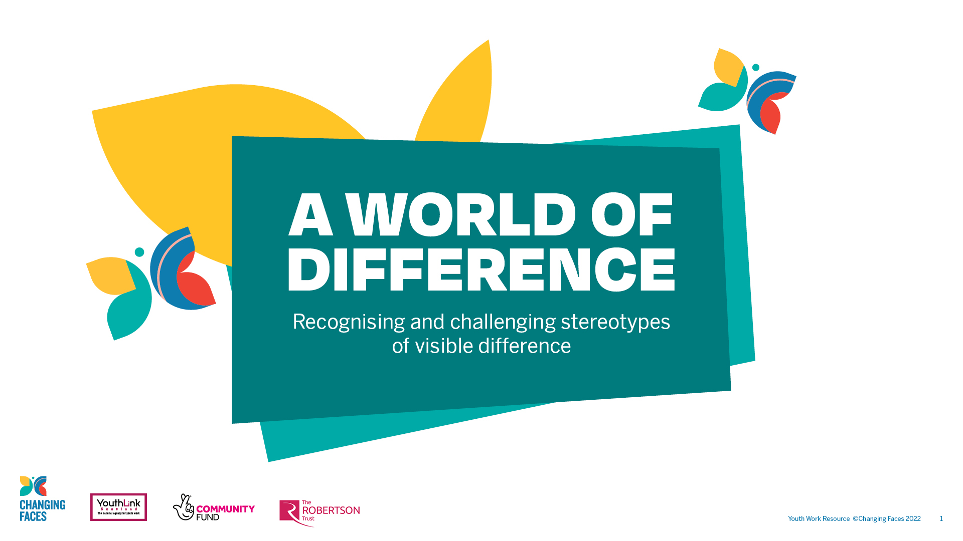

Slide 2

GROUP
DISCUSSION
What does the word stereotype mean?

Slide 3

A stereotype is an idea about a particular group
of people that is often oversimplified, untrue or unfair.

Slide 4
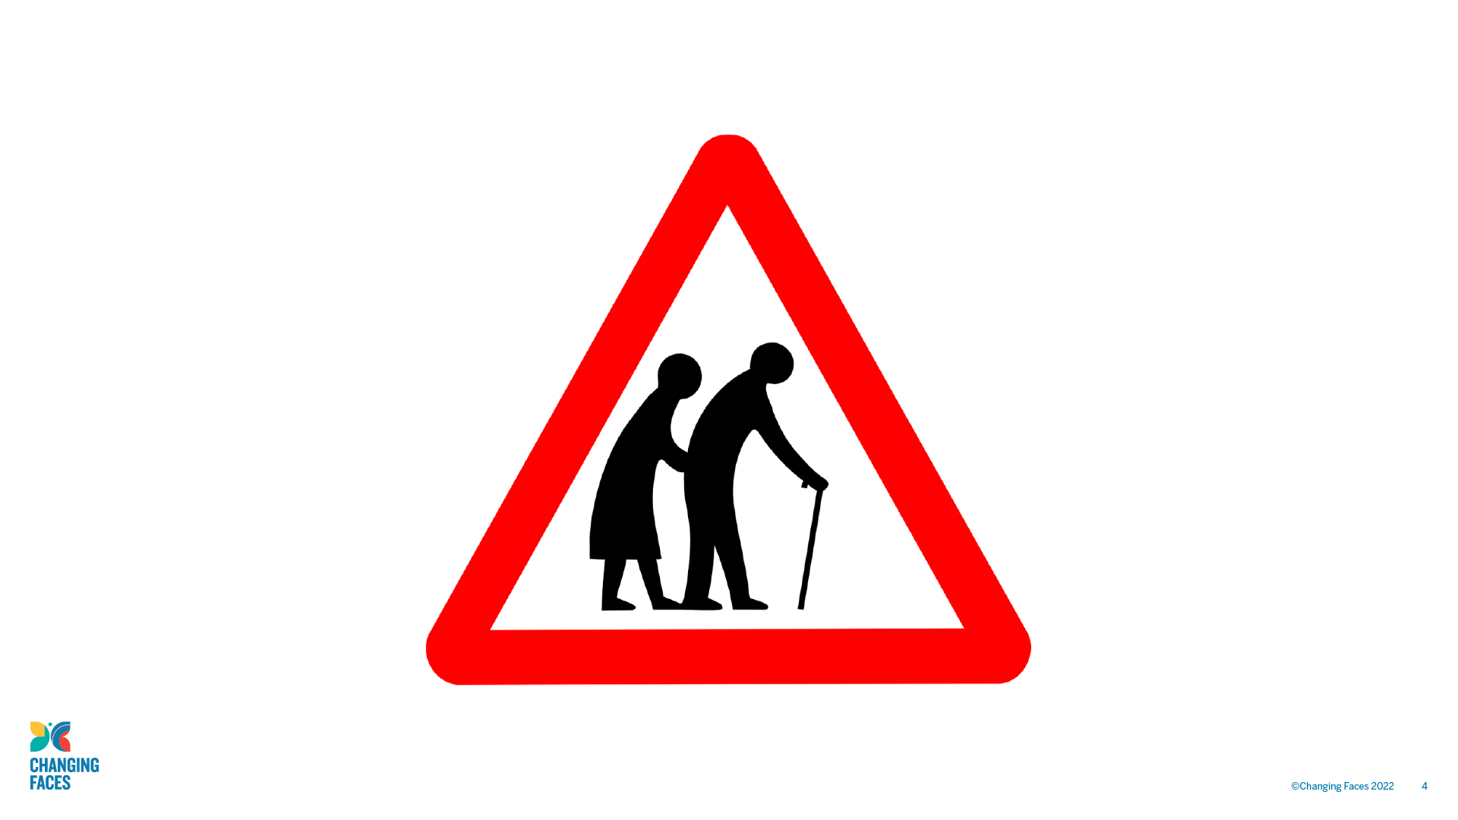

Slide 5
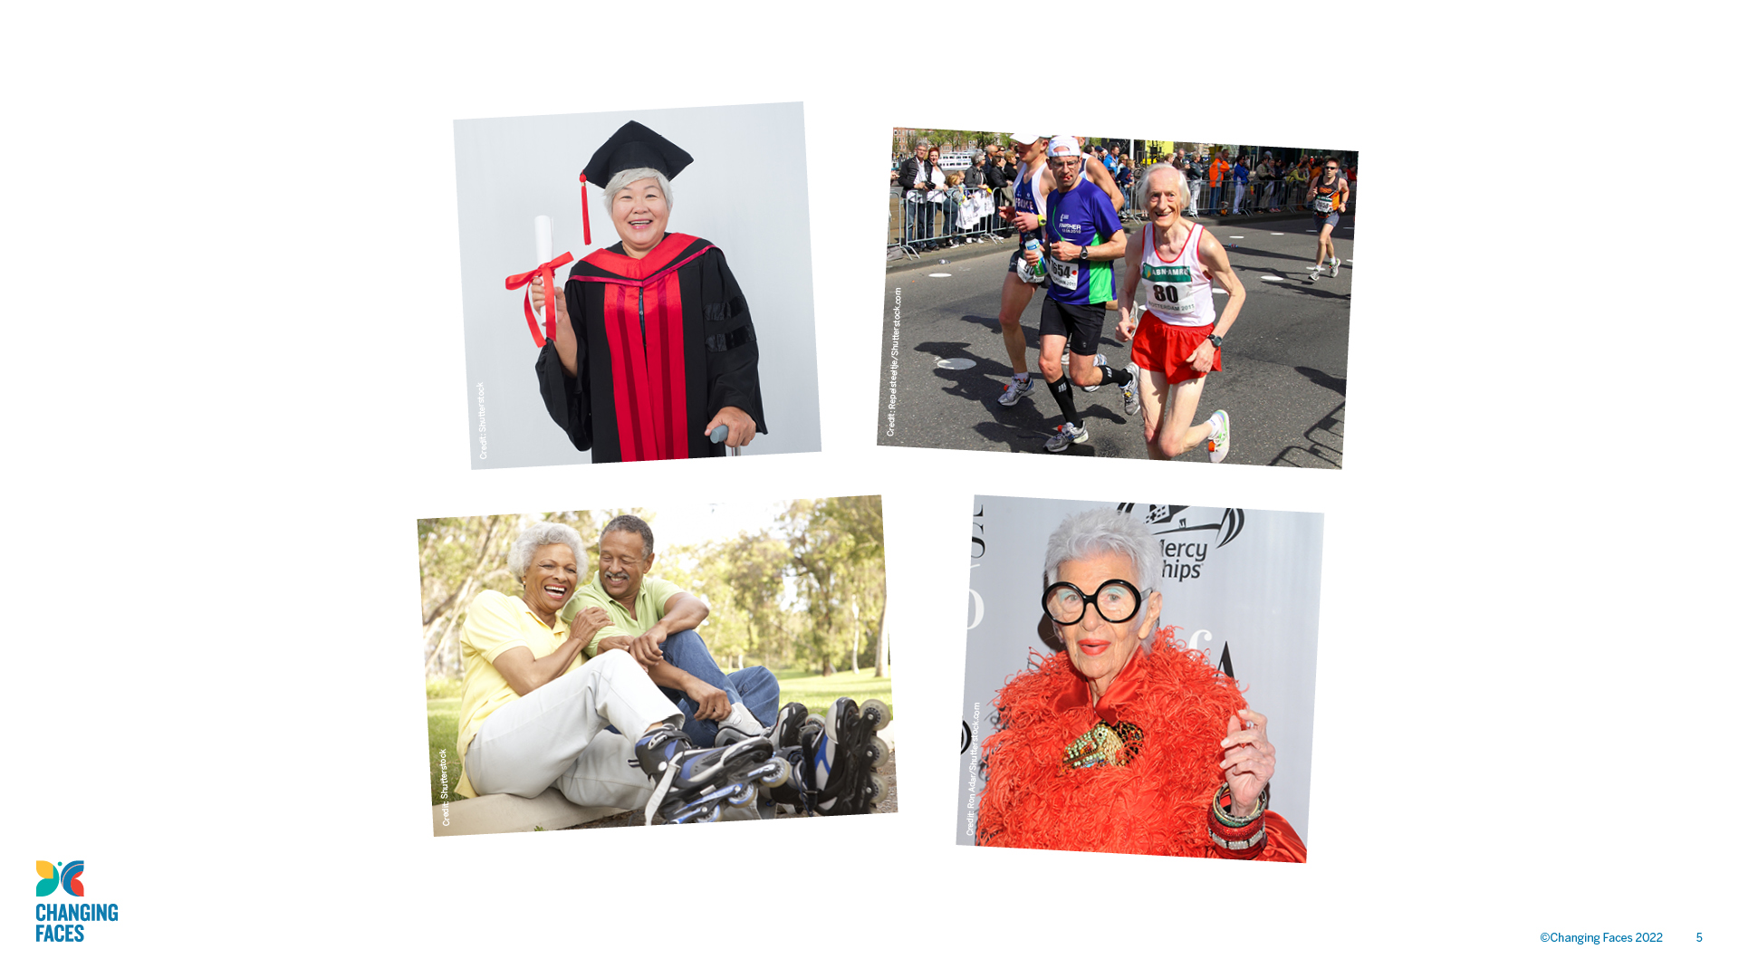

Slide 6

GROUP
DISCUSSION
What impact stereotypes have?

Slide 7

Today we’re going to be talking about how stereotypes
affect people who have a visible difference
(a mark, scar or condition that affects how they look).

Slide 8

Causes of a visible difference:
Skin conditions like eczema, acne, or vitiligo
Burns
Birthmarks
Craniofacial conditions, affecting the growth and development of the skull and face
Cleft lip/palate (a gap or split in the upper lip and/or roof of the mouth)
Cancer

Slide 9
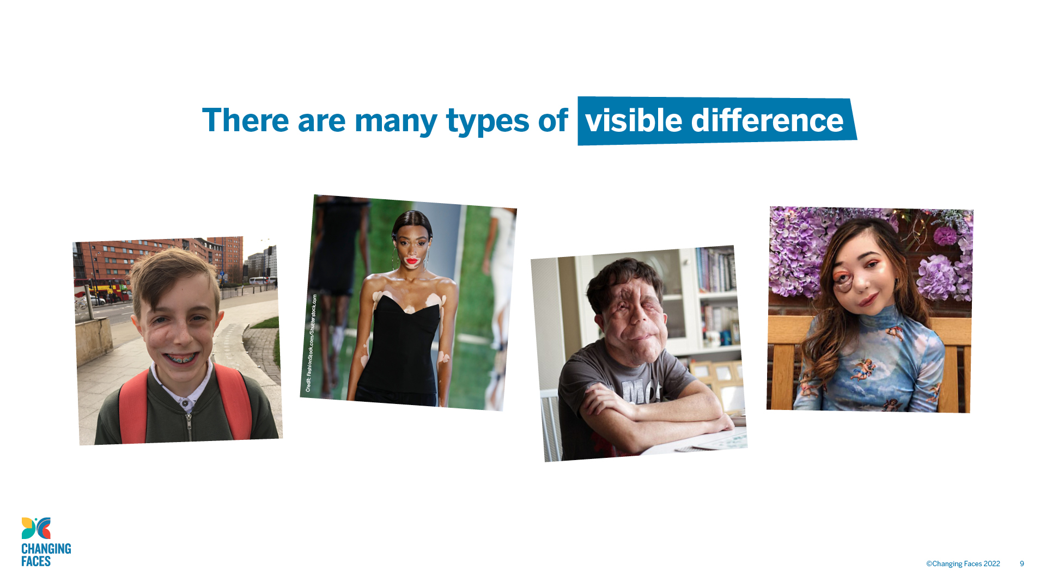

Slide 10

GROUP
ACTIVITY
Write a list of film or TV characters who have a scar, mark or condition that affects their appearance.

Slide 11
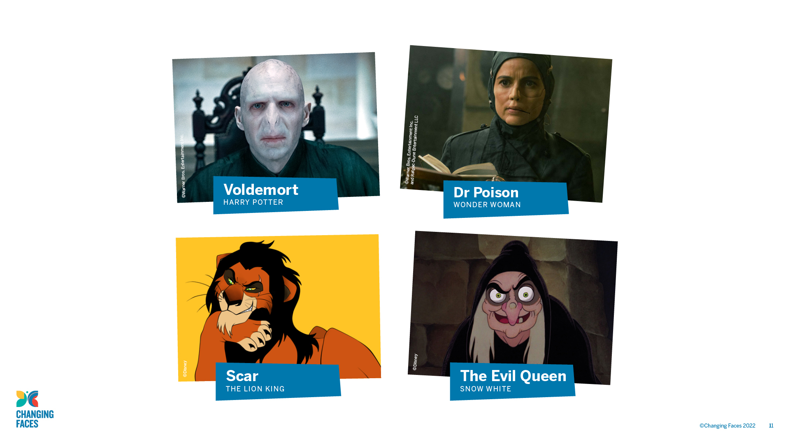

Slide 12

GROUP
DISCUSSION
What impact could stereotypical film and TV villains have on people who have a visible difference in real life?

Slide 13
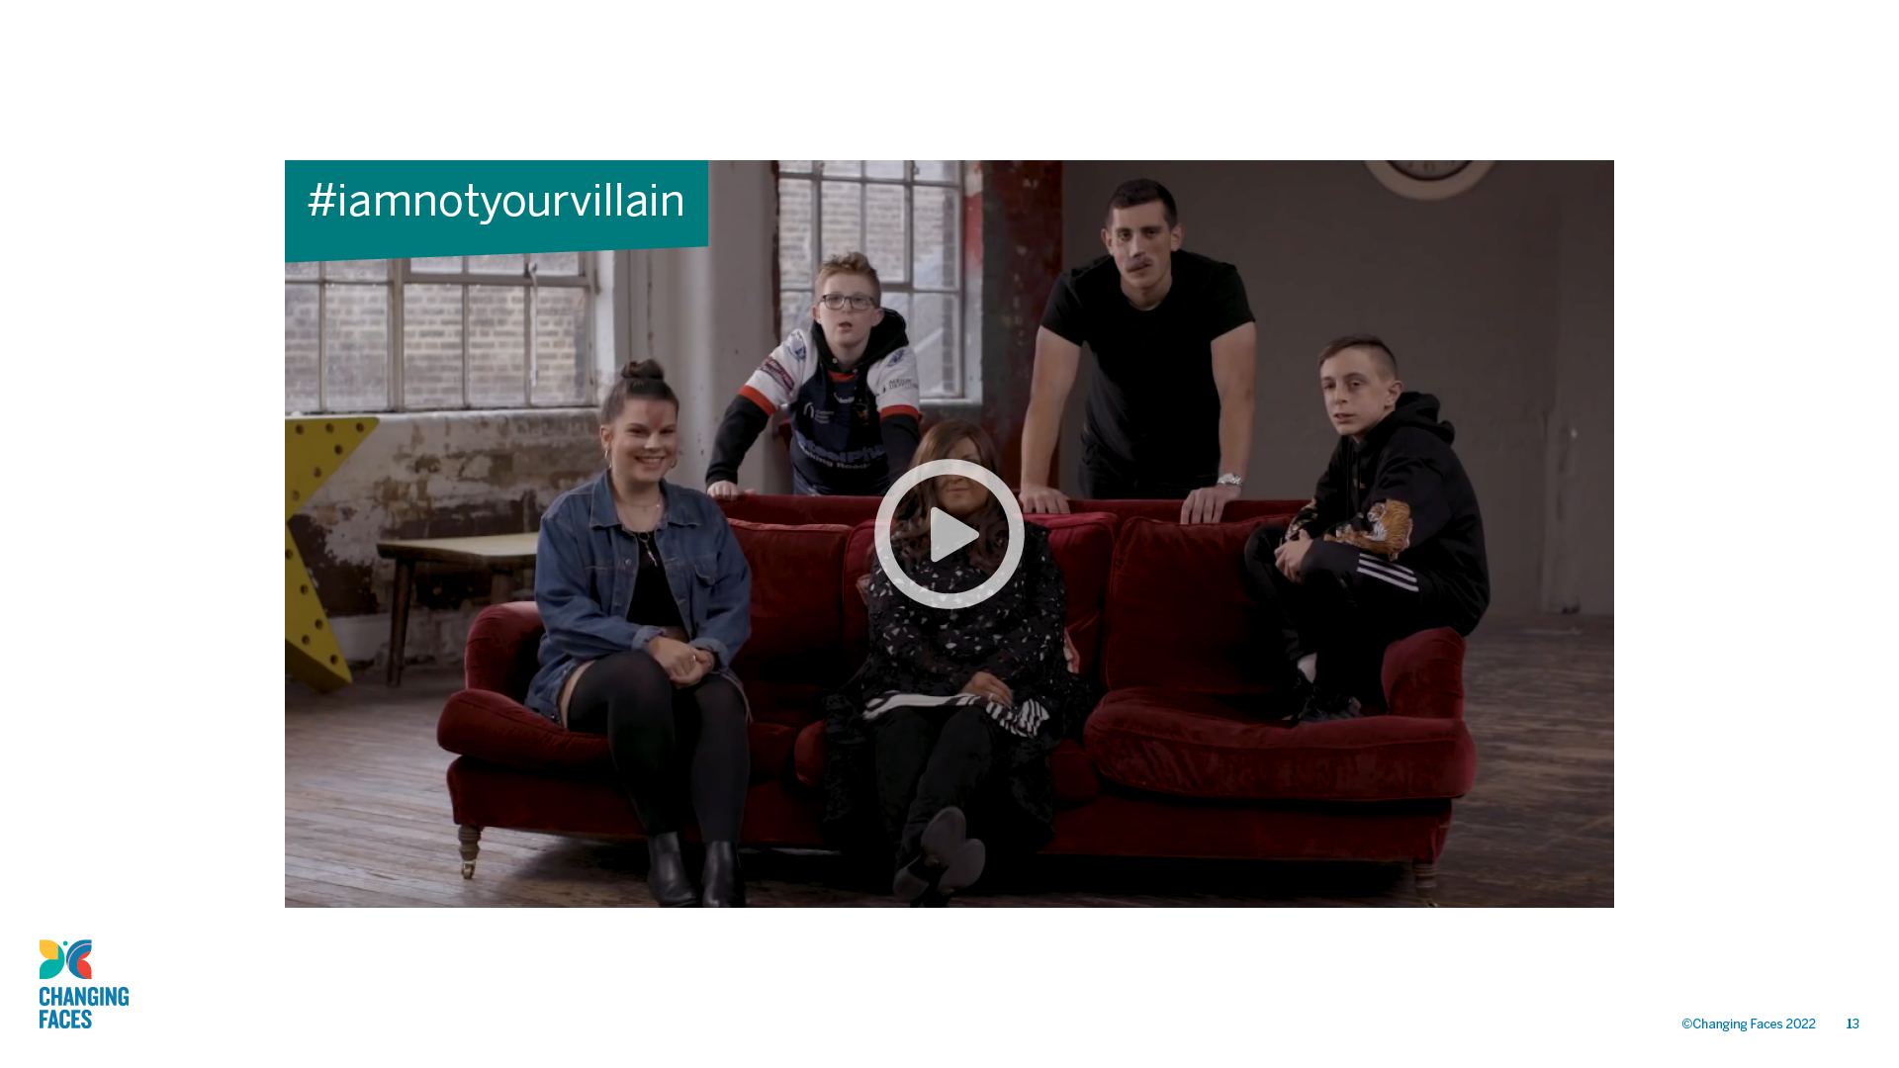

Slide 14

CHALLENGE
ACTIVITY
Why are small, 'cool' scars like Harry Potter's seemingly permissible in a hero, but anything else suggests villainy?

Slide 15
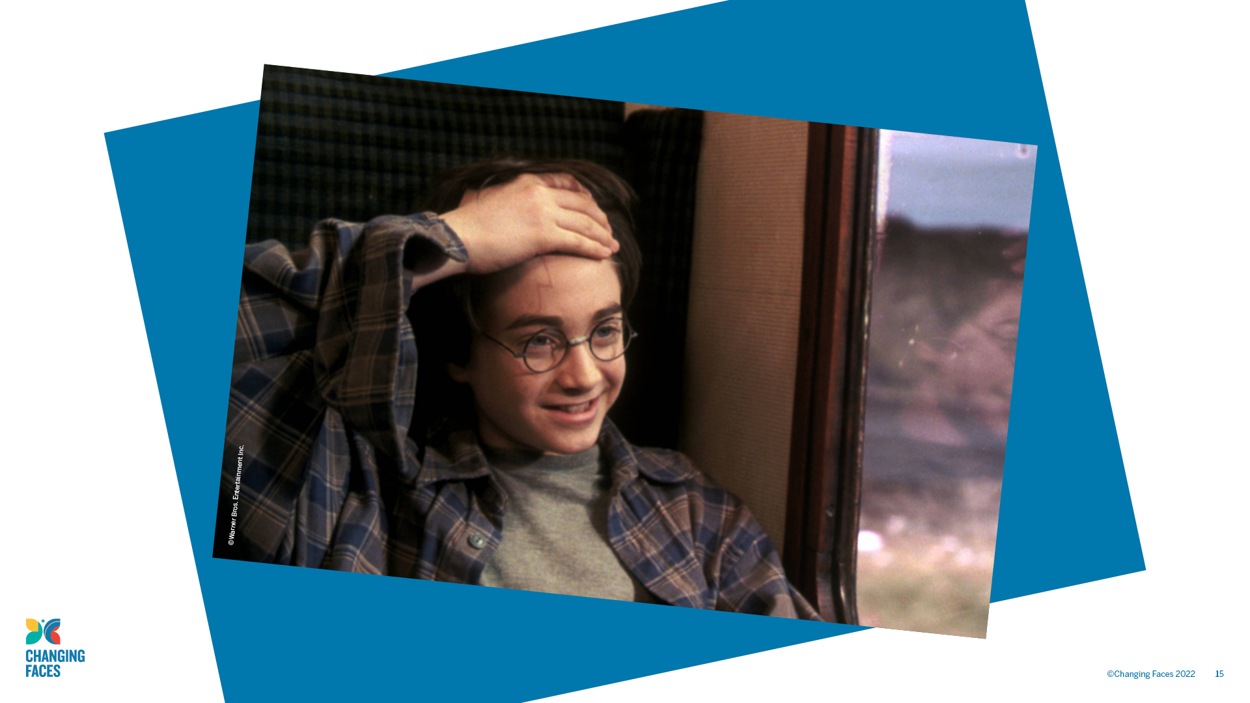

Slide 16

Other helpful websites:
youthlinkscotland.org
actiononprejudice.info
Find out more about visible differences
and respecting difference:
changingfaces.org.uk
Worried about anything we’ve discussed?
You can contact Childline for help:
childline.org.uk

